Slide 1
INTRODUCTION TO ASP.NET CORE
By: Bhawna Gunwani

Slide 2
ASP.NET CORE

Slide 3
ASP.NET Core Fundamentals

Slide 4
AGENDA
Action Methods and Result Types
Razor View Engine and Razor Syntax
Layout, Sections and View Start
HTML Helpers and Tag Helpers
Convention Routing and Attribute Routing
Demo: Configure Routing in ASP.NET Core
Data Passing Techniques
ViewData, ViewBag, TempData,
Sessions, Cookies and QueryString

Slide 5
Action Methods

Slide 6
ACTION METHODS
An action is a method that responds to user action/activity.
Any method in a controller which has public access modifier acts as an action method.
They are like any other normal methods with the following restrictions:
- Action method must be public. It cannot be private or protected.
- Action method cannot be overloaded.
- Action method cannot be a static method.

Slide 7
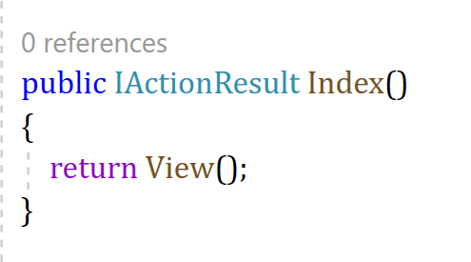
DEFAULT ACTION METHODS
Every controller can have default action method as per configured route in the RouteConfig.
By default, the Index() method is a default action method for any controller.
Also, you can change the default action name as per your requirement in the RouteConfig class.

Slide 8
Result Types

Slide 9
ACTION RESULT
MVC Framework includes various Result classes, which can be returned from an action method.
Result classes represents different types of responses, such as HTML, file, string, JSON etc.
ActionResult class is a base class of all the above result classes,
so it can be the return type of action method that returns any result.
However, you can specify the appropriate result class as a return type of action method.
The base controller class includes the View() method along with other methods that return
a particular types of result.

Slide 10
ACTION RESULT
Controller
Request or Response
Different types of Action Result
View

Slide 11
ACTION RESULT
The following table lists all the result classes with their base controller methods:
Result Class | Description | Base Controller Method
ViewResult | Represents HTML and markup. | View()
EmptyResult | Represents No response.
ContentResult | Result string literal. | Content()
FileContentResult | Represents the content of a file. | File()
RedirectResult | Represents a redirection to a new URL. | Redirect()
JsonResult | Represent JSON that can be used in AJAX. | Json()
PartialViewResult | Returns HTML from Partial view. | PartialView()
JavaScriptResult | Represents a JavaScript script. | JavaScript()
HttpUnauthorizedResult | Represents HTTP 403 response.

Slide 12
Razor View Engine

Slide 13
RAZOR VIEW ENGINE
It is responsible for producing HTML response when invoked by Controller Action method.
Controller Action methods returns some types of responses, which are called as Action Results.
The ViewResult is the ActionResult which produces the HTML Response.
The ViewResults are produced by the View Engine.
When the Controller Action method invokes the view() or PartivalView(),
it invokes the View Engine, which produces the HTML Response.

Slide 14
RAZOR VIEW ENGINE
The Razor View Engine is the default View Engine for the ASP.NET Core apps.
It looks for Razor markup in the View File and parses it and produces the HTML response.
It is used to generate views that are returned to the client's browser in response to a request.
It is a powerful and flexible templating engine.
With this, it is easier to create dynamic web pages in ASP.NET Core.
It enables developers to write clean and maintainable code that can be easily understood.

Slide 15
RAZOR VIEW ENGINE
HTML + C# Code
Pure HTML
View Engine
RazorView
Browser

Slide 16
RAZOR SYNTAX
Razor is a markup syntax for embedding .NET based code into webpages.
The Razor syntax consists of Razor markup, C#, and HTML.
Files containing Razor generally have a .cshtml file extension.
Razor syntax is similar to the templating engines of various JavaScript single-page application (SPA) frameworks, such as Angular, React etc.
Razor supports C# and uses the @ symbol to transition from HTML to C#.
When an @ symbol is followed by a Razor reserved keyword,
it transitions into Razor-specific markup. Otherwise, it transitions into plain HTML.

Slide 17


RAZOR SYNTAX
To escape an @ symbol in Razor markup, use a second @ symbol:
The code is rendered in HTML with a single @ symbol:

Slide 18
Layout View

Slide 19
LAYOUT VIEW
The layouts are like the master pages in Webforms applications.
A layout view defines the common layout or structure of multiple views in an application.
It allows you to define a consistent layout or structure for your application,
such as a header, footer, and navigation menu, which can be reused across multiple views.
It is used to define the structure of the HTML page and may contain placeholders for the
content that will be displayed by the views.

Slide 20
USE OF LAYOUT VIEW
Nowadays, almost all web applications have the following sections.
Website Header
Website Footer
Navigation Menus
Main Content Area
Instead of putting all the sections (i.e. the HTML) in each and every view pages,
it is always better and advisable to put them in a layout view
and then inherit that layout view in each and every view where you want that look and feel.
With layout views, now it is easier to maintain the consistent look and feel of your application.

Slide 21
USE OF LAYOUT VIEW
Website Header
Left Navigation Menus
Main Content Area
Website Footer

Slide 22
Sections View

Slide 23
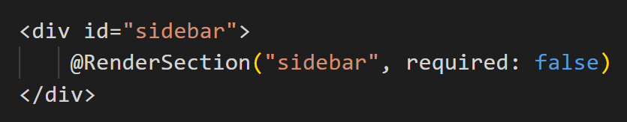
SECTIONS VIEW
Sections are a feature of layout views.
It defines and render blocks of content from the individual views that use the layout.
Sections provide a way for views to specify content that should be inserted into specific parts
of the layout view, such as a sidebar or a footer.
This can be useful when you want to reuse a common layout across multiple views.
To define a section, you can use the Razor syntax and the @RenderSection() directive.
Example, to define a section for a sidebar in a layout view, you could use the following code:

Slide 24
ViewStart

Slide 25
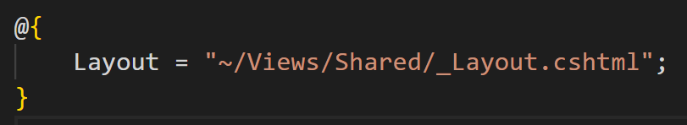
VIEWSTART
ViewStart allows you to define default settings and configurations for all the views.
It is essentially a partial view that is executed before any other view is rendered,
and can be used to set common properties such as the layout or master page, the view engine to use, or the default model type.
While creating ASP.NET MVC project, it includes a default ViewStart.cshtml file in Views folder.
For example, to set a default layout for all views in your application,
you can use the following code in your ViewStart file:

Slide 26
HTML Helpers

Slide 27
HTML HELPER
The HtmlHelper class renders HTML controls in the razor view.
It binds model object to HTML controls to display value of model properties into those controls,
and also assigns the value of the controls to the model properties while submitting a web form.
So always use the HtmlHelper class in razor view instead of writing HTML tags manually.
The difference between calling the HtmlHelper methods and using an HTML tags is that
- the HtmlHelper method is designed to make it easy to bind to view data or model data.

Slide 28
HTML HELPER
The following table lists the HtmlHelper methods and HTML control each method renders.
Extension Method | Strongly typed Method | HTML Control
Html.ActionLink() | NA | <a></a>
Html.TextBox() | Html.TextBoxFor() | <input type="textbox">
Html.TextArea() | Html.TextAreaFor() | <input type="textarea">
Html.CheckBox() | Html.CheckBoxFor() | <input type="checkbox">
Html.RadioButton() | Html.RadioButtonFor() | <input type="radio">
Html.DropDownList() | Html.DropDownListFor() | <select> <option> </select>
Html.ListBox() | Html.ListBoxFor() | multi-select list box: <select>
Html.Hidden() | Html.HiddenFor() | <input type="hidden">

Slide 29
Tag Helpers

Slide 30
TAG HELPER
Tag helper is a new feature in ASP.NET MVC.
It enables server-side code to create and render HTML elements in Razor View.
It is a feature of Razor View engine.
They are the C# classes which participate in view generation by creating the HTML elements.
We can change the content of HTML element and add additional attributes to HTML element.
It is very similar to HTML helper in ASP.NET MVC.

Slide 31
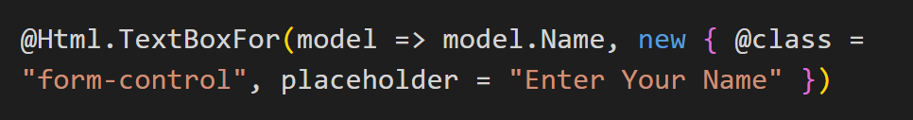
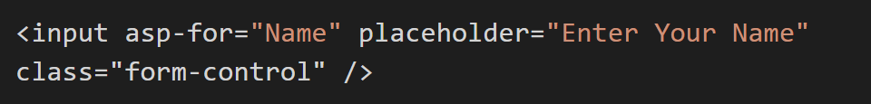
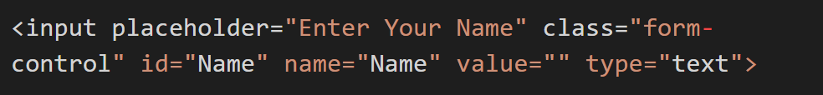
TAG HELPER
HTML HELPER:
EQUIVALENT WITH TAG HELPER:
EQUIVALENT HTML:

Slide 32
ADVANTAGES OF TAG HELPER
An HTML-friendly development experience
A rich IntelliSense support
More robust, reliable, and maintainable code
It also executes the metadata that sets using Data Annotation in the View Models/Models.

Slide 33
Routing- Convention and Attribute Routing

Slide 34
CONVENTION ROUTING
It is used for defining routes based on conventions and defaults,
rather than explicitly defining each route.
Developers define a set of conventions that are used to generate routes for different types of controllers and actions.
It provides a simple and flexible way to define routes in an ASP.NET Core application.
The URL pattern is generated based on the names of the controller and action methods.

Slide 35
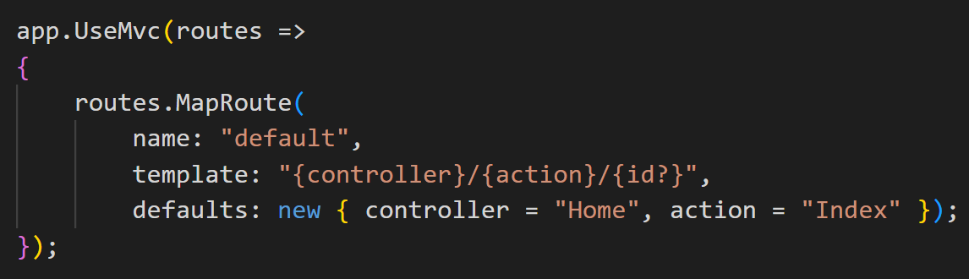
CONVENTION ROUTING
For example, consider the following code:
This code sets up a default route that maps URLs in the format of /{controller}/{action}/{id}.
When a request arrives, the routing middleware uses this route definition to match the incoming URL to the appropriate controller and action method.

Slide 36
ATTRIBUTE ROUTING
It is a technique used for defining routes directly in the controller code using attributes.
Developers can specify the URL pattern for a particular action method using attributes,
instead of relying on conventions or explicit route definitions.
In attribute routing, [Route] attribute is used to specify the URL pattern for an action method.
By specifying the route directly in the controller code, developers can have fine-grained control over the URL patterns for each action method.

Slide 37
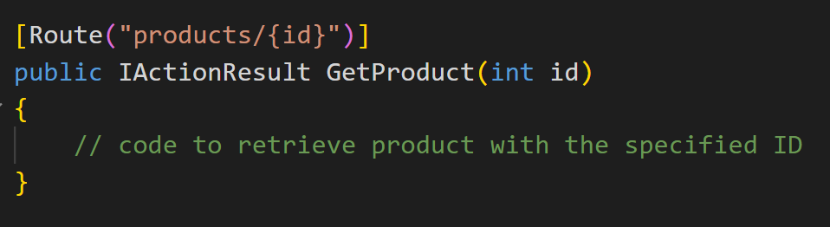
ATTRIBUTE ROUTING
For example, consider the following code:
In this example, the [Route] attribute specifies that the GetProduct method should be invoked for URLs in the format of /products/{id}.
The {id} placeholder in the URL pattern is replaced with the value of the id parameter.

Slide 38
Configure Routing in ASP.NET Core
DEMO

Slide 39
Data Passing Techniques

Slide 40
DATA PASSING TECHNIQUES
The best and popular method to pass the data to the view from the controller is through the help of model classes which are normally known as view class.
Since in the interface, we normally use the strongly type views,
so it is very much easy to access the object or model which need to pass the controller.
we can perform this operation with the help of the different type of data passing techniques.

Slide 41
DATA PASSING TECHNIQUES
The following are the object which store value and transfer it from one place to other place:
Data Passing Techniques
ViewData
ViewBag
TempData
Session
Cookies
QuerySring

Slide 42
ViewBag vs. ViewData vs. TempData

Slide 43
VIEWBAG
The ViewBag is used to transfer temporary data,
which is not included in the model from the controller to the view.
Internally, it is a dynamic type property of the ControllerBase class which is the base class of the Controller class.
It is often used for simple scenarios where a strongly typed model is not required.
@ViewBag.Name
@ViewBag.Name =“John”
ViewBag
View
Controller

Slide 44
VIEWDATA
ViewData is used to pass the data from the controller action method to a view and we can display this data on the view.
The ViewData is work on the principle of Key-value pairs.
This type of binding is known as loosely binding.
We can pass any type of data like normal integer, string, even though you can pass objects.
ViewData only transfers data from controller to view, not vice-versa. It is valid only during the current request.
@ViewData[“Name”]
@ViewData[“Name”]=“John”
ViewData
View
Controller

Slide 45
Working with TempData

Slide 46
TEMPDATA
TempData is used to transfer data from the view to the controller, the controller to the view,
or from an action method to another action method of the same or a different controller.
TempData temporarily saves data and deletes it automatically after a value is recovered.
Unlike ViewBag and ViewData TempData can hold the value for several successive queries.
TempData can be used in a couple of scenarios like:
Passing Data from Controller to View.
Transmit data from one activity to another.

Slide 47
TEMPDATA
TempData
Controller
Controller
ViewData/ViewBag
TempData
View

Slide 48
USES OF TEMPDATA
It is used for storing data between two sequential queries.
It is similar to a session, which is brief, and uses an internal session to store data.
We can use the loop to access each key and its value sent to the server.
To prevent execution time errors, check the NULL values.
Temporary data is mainly used in messages like error messages or validation messages which store a time message.
To supply all values of the template in a third request, we can use Call TempData.Keep().

Slide 49
Session

Slide 50
SESSION
Sessions provide a way to store user-specific data across requests.
A session is a way to persist data between requests for the same user,
even if they close their browser or leave the application.
When user visits a website, server creates a unique session ID, and sends it to client in cookie.
The client then includes this session ID in subsequent requests,
allowing the server to associate the requests with a specific session.
ASP.NET Core provides a built-in ISession interface that represents a session object.

Slide 51
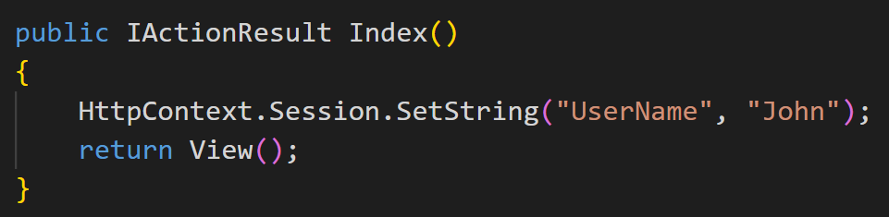
SESSION
In the below example, we are setting a string value "John" in the session with key "UserName".

Slide 52
Cookies

Slide 53
COOKIES
A cookie is a piece of data from a website that is stored within a web browser that the website can retrieve at a later time.
Cookies are used to tell the server that users have returned to a particular website.
Specific cookies known as HTTP cookies are used to identify specific users,
and improve your web browsing experience.
ASP.NET Core uses cookies to maintain the session state;
The cookie that contains the session ID is sent to the client with each request.

Slide 54
COOKIES
There are basically two types of cookies:
Session Cookies:
- When you visit a website, these cookies are stored on computer only for duration of your visit.
- This is destroyed when you leave your browser or move away from a web page.
Persistent Cookies:
- Persistent cookies can store information accessible across multiple sessions.
- Generally, these cookies store login information or preferences.

Slide 55

COOKIES
WRITE COOKIE:
READ COOKIE:

Slide 56
QueryString

Slide 57

QUERYSTRING
A query string is a collection of characters input to a computer or web browser.
A Query String is helpful when we want to transfer a value from one page to another.
When we need to pass content between the HTML pages or aspx Web Forms,
A Query String is very easy to use and the Query String follows a separating character, usually a Question Mark (?).
It is basically used for identifying data appearing after this separating symbol.
Syntax:

Slide 58

Thank You

